Slide 1

The most effective learning system. World’s highest course completion rate
Assignment 1 - Multi-Modal LLM
By: R. Mrudula

Slide 2

Table of Contents
1. Introduction to Large Language Models (LLMs)
Overview & How They Work
Common Uses & Challenges
2. Multimodal Large Language Models (MLLMs)
What Are MLLMs?
The Rise of Multimodality in AI
3. Architecture of MLLMs
Modality Encoder
LM Backbone
Modality Interface
4. How MLLMs Work
Data Processing & Feature Extraction
Cross-Modal Attention & Fusion
Training & Inference
5. Popular MLLMs & Their Applications
Models
Use Cases
6. Challenges & Limitations

Slide 3
Introduction to Large Language Models
Overview & How They Work
Large Language Models (LLMs) are advanced artificial intelligence models trained on vast amounts of textual data to understand, generate, and process human language. They use deep learning architectures, primarily Transformer-based models (like GPT, BERT, and T5), to perform various NLP tasks such as text generation, translation, summarization, and question-answering.
How LLMs Work
1. Training on Large Datasets: They learn patterns, grammar, facts, and reasoning from diverse text sources (books, articles, code, etc.).
2. Self-Attention Mechanism: Enables them to understand word relationships and context better than traditional models.
3. Pre training & Fine-Tuning:
Pre training: Learning general language understanding from large datasets.
Fine-Tuning: Adapting to specific tasks like chatbots, summarization, or code generation.

Slide 4
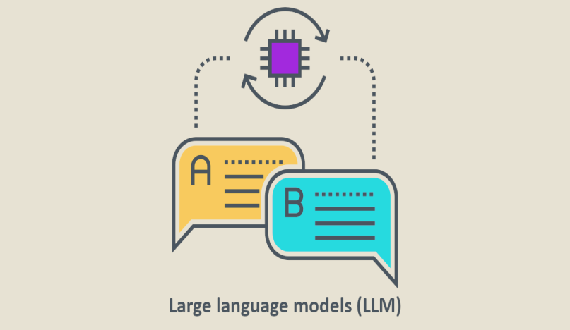
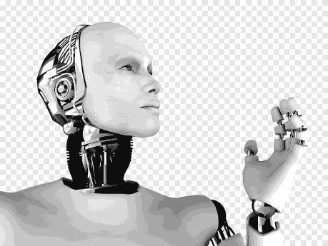
Introduction to Large Language Models
Common Uses of LLMs
Chatbots (ChatGPT, Bard)
Text Summarization (T5, BART)
Code Generation (Codex, Copilot)
Machine Translation (mT5, M2M-100)
Content Creation & SEO Optimization
Challenges
Bias & Ethical Concerns
High Computational Cost
Hallucinations (Generating incorrect info)

Slide 5
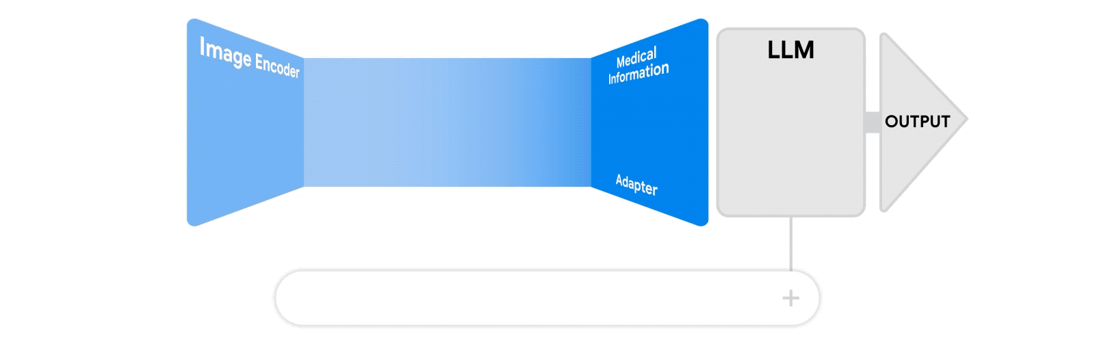
Multimodal Large Language Models(MLLMs)
What are MLLMs?
Multimodal Large Language Models (MLLMs) are AI systems that can
that can handle and generate content across various modalities, going beyond just text.
Unlike traditional LLMs that primarily focus on text, MLLMs can integrate and process information from different sources, like images, audio, and video, alongside text.
Below figure illustrates a multimodal AI system in healthcare . It receives two inputs: 1) a medical image and 2) a query in text. The system output consists of an answer (i.e: a prediction) to the given query.

Slide 6
Multimodal Large Language Models(MLLMs)
Improved Data Fusion
Enhanced
Performance
AI
Real World Applications

Slide 7
The rise of multimodality in Artificial Intelligence
Over the past few years, there has been a significant transformation in Artificial Intelligence, largely driven by the rise of Transformers in Language Models.
This transformation has been driven by advances in Transformer architectures, particularly after the success of models like GPT, BERT, and ViTs (Vision Transformers).
Key factors contributing to this rise (Core Concepts) :
Improved Data Fusion: AI now integrates different modalities through techniques like early, mid, and late fusion for better contextual understanding.
Enhanced Performance: Multimodal models, such as CLIP and GPT-4o, provide richer, more accurate responses by leveraging diverse data sources.
Real-World Applications: Used in healthcare (diagnostic AI), content generation, autonomous vehicles, and human-machine interaction.
This shift is making AI more versatile, accurate, and human-like in understanding and responding to complex inputs.

Slide 8
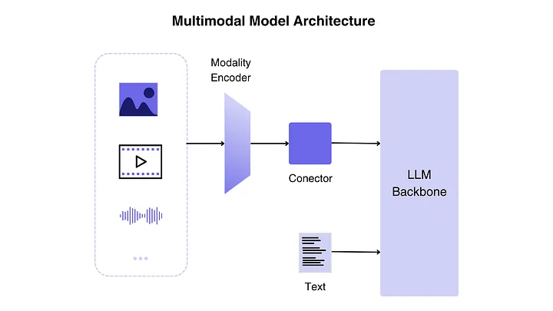
Architecture of MLLMs

Slide 9
Architecture of MLLMs
The architecture of a MLLM is divided in three parts:
Modality encoder: The encoding components condense raw data formats like visuals or sound into a more streamlined representation. Instead of beginning the training process from the ground up, a prevalent strategy involves utilizing a pre-trained encoder (e.g., CLIP) that has been calibrated to other modalities.
LLM backbone: A language model is required to output responses in text. It acts as the “brain” of the MLLM. The encoder is fed with images, audio or video and generates features, which are processed by a connector (or modality interface).
Modality interface (i.e., conector): This functions as an intermediary or link between the encoder and the LLM. Since LLMs can only interpret text, it’s crucial to connect text with other modalities effectively.

Slide 10
Working of MLLMs
Data Pre-processing
Feature Extraction
Cross-Modal Attension
Joint Rrepresentation
Multimodal Fusion
Training
Inference

Slide 11
How MLLMs Work
MLLMs integrate and process information from multiple data modalities, such as text, images, audio, and video, to understand and generate comprehensive responses. Here’s a breakdown of how they work:
Data Preprocessing: Each type of data is pre-processed to make it suitable for the model. This involves techniques like tokenization for text, feature extraction for images, and signal processing for audio. Pre-processing ensures that the data is in a format the model can understand.
Feature Extraction: MLLMs use specialized neural networks to extract relevant features from each modality. For example:
Text: Natural language processing (NLP) techniques extract linguistic features, such as syntax and semantics.
Images: Convolutional neural networks (CNNs) detect visual features like shapes, colours, and objects.
Audio: Recurrent neural networks (RNNs) or convolutional neural networks (CNNs) analyze sound patterns and frequencies.
Video: Combines techniques from both image and audio processing to understand visual and auditory components over time.

Slide 12
How MLLMs Work
Cross-Modal Attention: Cross-modal attention mechanisms allow the model to focus on relevant parts of the data across different modalities. This process helps the model to align and integrate information, ensuring that the response is coherent and contextually appropriate. For instance, while generating a description of an image, the model can focus on both the visual content and any accompanying text to produce a more accurate description.
Joint Representation: The model creates a joint representation by combining the processed features from each modality. This representation captures the relationships and dependencies between the different types of data, allowing the model to generate integrated and contextually rich outputs.

Slide 13
How MLLMs Work
Multimodal Fusion: Various fusion techniques are used to combine the features from different modalities. Early fusion integrates the features at the initial stages of processing, while late fusion combines them after each modality has been processed independently. Hybrid approaches can also be used to balance the advantages of both methods.
Training: MLLMs are trained using large datasets that include paired examples of different modalities (e.g., images with captions, videos with audio descriptions). The training process involves optimizing the model to minimize the error in predicting outputs based on the integrated multimodal input. Techniques such as back-propagation and gradient descent are used to adjust the model's parameters.
Inference: During inference, the trained model processes new multimodal inputs using the same steps: pre-processing, feature extraction, encoding, cross-modal attention, and multimodal fusion. The model then generates responses or predictions based on the joint representation of the input data.

Slide 14
Popular MLLMs
1. CLIP (Contrastive Language–Image Pre-training)
Developed by: OpenAI
CLIP is designed to understand images and text by learning a wide variety of visual concepts from natural language descriptions. It can perform tasks such as image classification, object detection, and image captioning without task-specific training.
2. DALL-E
Developed by: OpenAI
Description: DALL-E generates images from textual descriptions, showcasing the ability to create visual content based on detailed text prompts. It demonstrates the integration of language and vision capabilities

Slide 15
Popular MLLMs
3. Florence
Developed by: Microsoft
Description: Florence is a foundation model designed for computer vision tasks. It integrates textual descriptions with visual data to perform various tasks, including image captioning and visual question answering.
4. ALIGN (Vision-Language Pre-training)
Developed by: Google Research
Description: ALIGN is a model trained to understand and generate text from images by aligning visual and linguistic representations. It can perform cross-modal retrieval and zero-shot image classification.
5. ViLBERT (Vision-and-Language BERT)
Developed by: Facebook AI
Description: ViLBERT extends the BERT architecture to handle visual and textual data simultaneously. It can be used for tasks such as visual question answering and visual common sense reasoning.

Slide 16
Use Cases
Image Captioning
Visual Question Answering (VQA)
Content Creation
Medical Diagnostics
Autonomous Vehicles
Robotics
E-commerce
Education & Accessibility

Slide 17
Challenges & Limitations
Data Alignment Issues
High Computational Costs
Bias & Ethical Concerns
Lack of Robustness
Interpretability Challenges
Limited Generalization

Slide 18
References
https://www.geeksforgeeks.org/exploring-multimodal-large-language-models
https://medium.com/@tenyks_blogger/multimodal-large-language-models-mllms-transforming-computer-vision-76d3c5dd267f
https://medium.com/@cout.shubham/exploring-multimodal-large-language-models-a-step-forward-in-ai-626918c6a3ec
https://www.linkedin.com/pulse/what-multimodal-large-language-models-mllms-atul-yadav/
https://blog.purestorage.com/purely-educational/the-difference-between-llms-and-mllms/

Slide 19
THANK YOU

